Slide 1
Astro 331 Lesson 13
Command and Data Handling Subsystem (C&DH) / Telemetry, Tracking and Command (TT&C)
SMAD Ch 11.2-11.3, 13.2, 13.3.3, 16.1.1-16.1.2, Supp Crs Mtl

Slide 2
Lesson Objectives
Explain spacecraft command and data handling subsystem functions
Understand the different types of analog signals
Understand the terms CPU, I/O, RAM, PROM and Flash memory
Explain spacecraft telemetry, tracking and command functions
Understand and be able to describe a block diagram of a generic TT&C subsystem
List and describe the different types of modulation commonly used for digital signal transmission in satellite communications
Compute discrete values, quantization step size, and maximum error for analog-digital converters
Use a Hamming code to construct a transmit message or to analyze a received message

Slide 3
Command & Data Handling (C&DH)

Slide 4
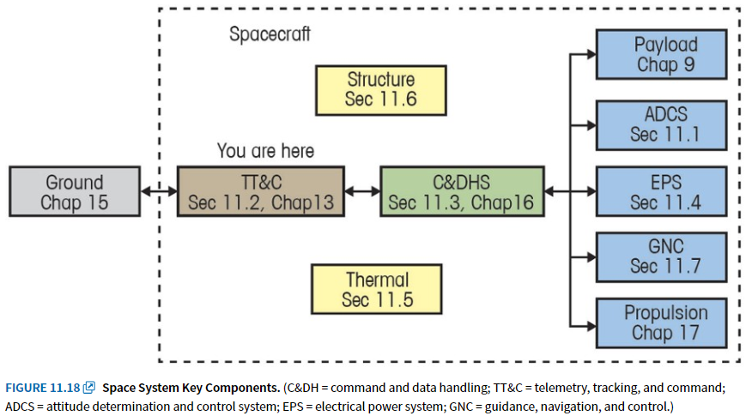
Designing Space Missions and Systems, Figure 11.18

Slide 5
C&DH Main Functions
receives, validates, decodes, and distributes commands to other S/C subsystems
gathers, processes, and formats S/C housekeeping & mission data for downlink
payload data
images, communication, etc.
typically much more data than housekeeping data
housekeeping data
S/C health (temps, voltages & currents, attitude info, component health status, etc)
S/C timekeeping, computer health monitoring (watchdog), security interfaces

Slide 6
Commanding
Command decoder handles two types of commands: discrete or serial
Discrete: fixed amplitude, fixed pulse width
Serial: 3-signal interface consisting of a shift clock, serial command data, and a data enable used to indicate if the interface is active

Slide 7
Data Handling
Data handling system: combines telemetry from multiple sources and provides it for downlink or internal spacecraft use
Telemetry (remote metering): measurement of data from a distance
may be bi-level, serial digital, or analog
Analog: continuous (as opposed to discrete) data
High-Level Analog: telemetry channel with information encoded as an analog voltage, typically in the range of 0 – 5.2 V
Low-Level Analog: telemetry channel with information encoded as an analog voltage, but with a low enough range that amplification is required
Passive Analog: telemetry channel with information encoded as a resistance; a constant current is supplied to sensor and resulting voltage drop is signal

Slide 8
Terms Definitions
CPU – Central Processing Unit
Where processing occurs
Electronic circuitry that executes instructions, including performing basic arithmetic, logic, controlling, and input/output (I/O) operations
I/O – input/output devices
Allows computer to communicate with other devices
RAM – Random access memory
Volatile storage: memory that only retains information while computer is powered
Fast: memory device that allows data items to be read or written in almost the same amount of time irrespective of the physical location of data inside the memory
Used to record and store data quickly
PROM – Programmable read-only memory
Non-volatile storage: memory that retains information when not powered
Permanent: Form of digital memory where the contents can be changed once after manufacture of the device, but once written, the data is then permanent and cannot be changed
Used to store spacecraft software “image” which is like an operating system, which ideally is not changed during the mission
Flash memory
Non-volatile memory storage that can be electrically erased and reprogrammed
Fast read-access time, mechanically shock-resistant
Can endure only a relatively small number of write cycles for a single block

Slide 9
BONUS Info
Microcontroller
single metal-oxide semiconductor integrated circuit that combines functions of CPU, RAM, ROM, I/O peripherals on same board
Advantages: simple to program, best for simple, hardware specific application, less expensive than FPGA
Disadvantages: can only perform limited tasks, serial processing (one instruction at a time), hardware is limited
FPGA – field programmable gate array
A semiconductor integrated circuit with millions of logic gates designed to be configured by a customer after manufacturing “field-programmable”
Advantages: hardware is programmable, can do parallel processing
Disadvantages: complex to configure, consumes more power than a microcontroller, no internal oscillator (clock)

Slide 10
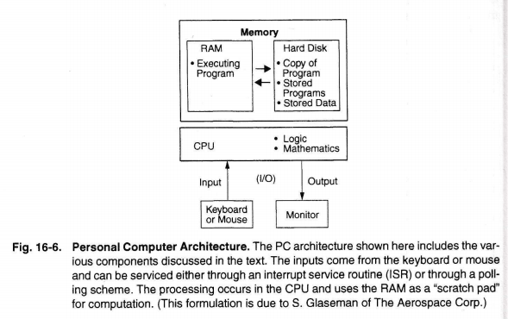

Slide 11
Telemetry, Tracking & Command (TT&C)

Slide 12
Designing Space Missions and Systems, Figure 11.18

Slide 13
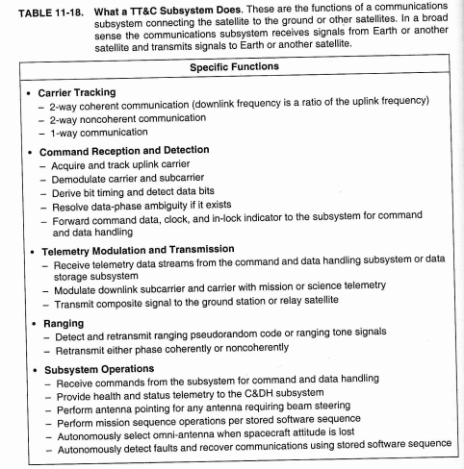
TT&C Functions

Slide 14
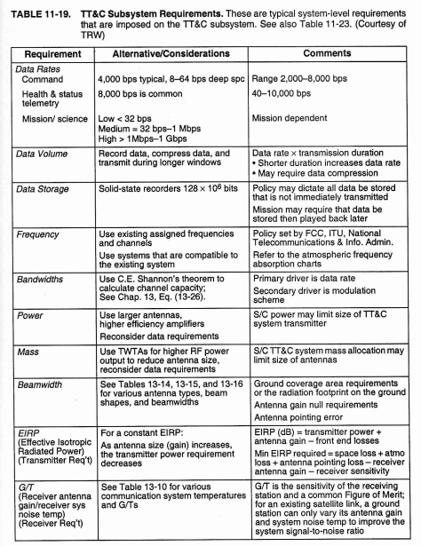
TT&C Req’ts

Slide 15
TT&C Information
Because all S/C communicate with users and operations on the ground, de-conflict frequencies, orbital locations, and power levels are critical; must apply to regulatory bodies for:
Desired communication frequencies
Orbital assignment
Desired power flux density on surface
ITU (International Telecommunications Union), part of the UN
coordinates and approves satellite radio frequency and orbit requests
Classic trades for TT&C include:
Size of antenna aperture vs transmitter power
Solid-state amplifiers vs travel-wave tube amplifiers (TWTAs)
S/C complexity vs Ground complexity

Slide 16
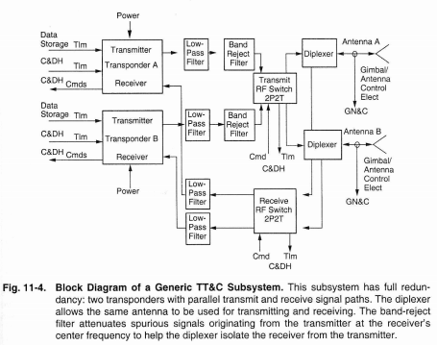

Slide 17
Modulation
Modulation: the process by which an input signal varies the characteristic of a radio frequency carrier
Characteristics are: amplitude, phase, frequency, and polarization
Types of Modulation
Binary Phase Shift Keying (BPSK): setting the career phase at 0 deg to transmit a binary 0 and setting phase at 180 deg to transmit a binary 1
Quadriphased phase shift keying (QPSK): defines two bits at a time with 0 deg, 90 deg, 190 deg or 270 deg
Frequency Shift Keying (FSK): sets carrier frequency at F1 to transmit a inbary 0 and F2 to transmit a binary 1
Multiple Frequency Shift Keying (MFSK): sets carreer frequency to one of M frequencies; can represent multiple bits with one frequency (eg 8FSK: one frequency represents three bits (2³=8)

Slide 18
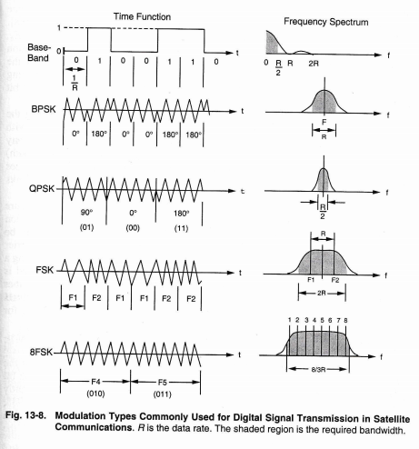

Slide 19
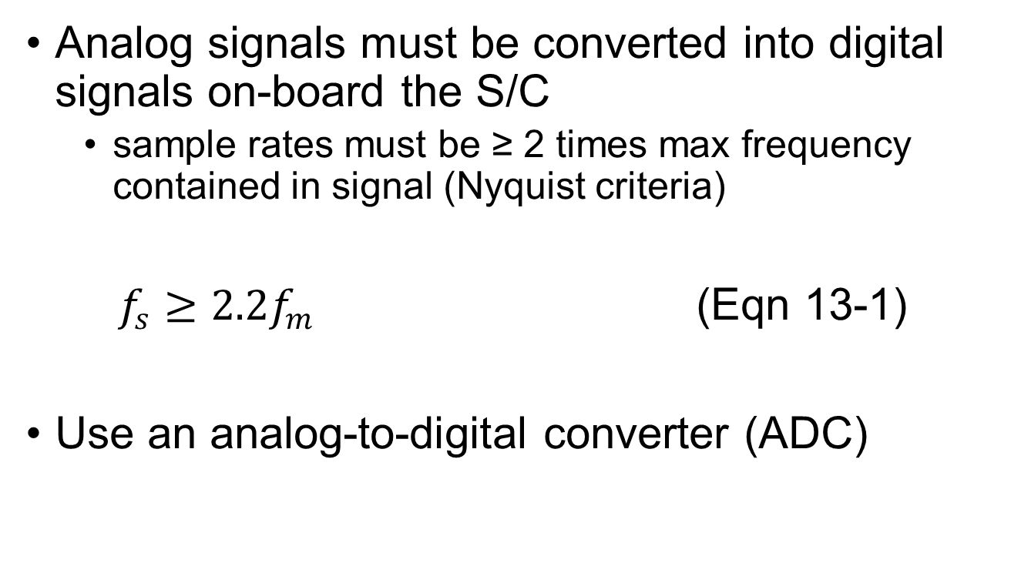
Analog to Digital Conversion
Analog signals must be converted into digital signals on-board the S/C
sample rates must be ≥ 2 times max frequency contained in signal (Nyquist criteria)
$f_{s}≥2.2f_{m}$ (Eqn 13-1)
Use an analog-to-digital converter (ADC)

Slide 21
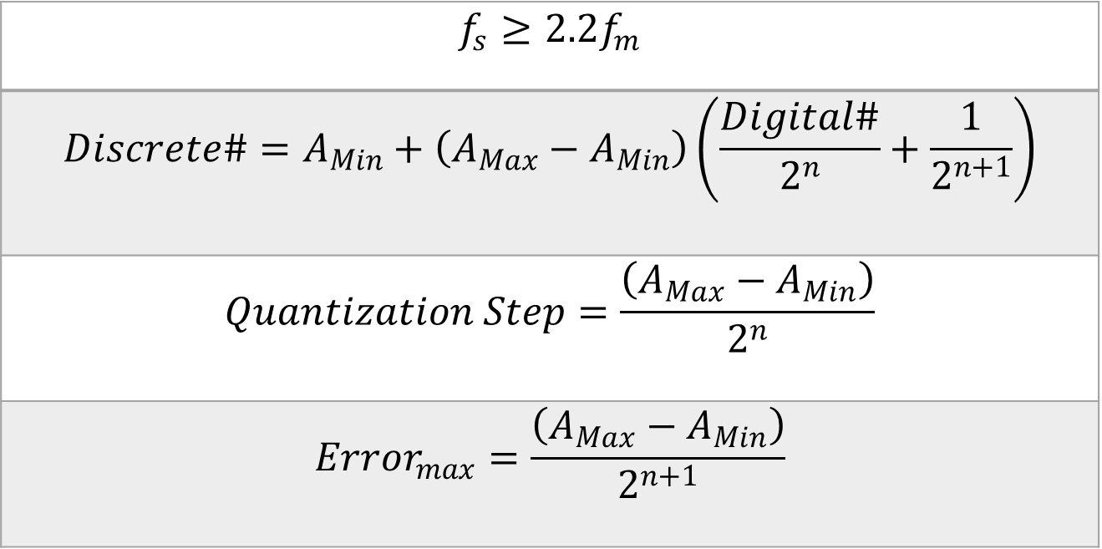
Analog-to-Digital Equations
$$f_{s}≥2.2f_{m}$$
$$Discrete\#=A_{Min}+\left(A_{Max}−A_{Min}\right)\left(\frac{Digital\#}{2^{n}}+\frac{1}{2^{n+1}}\right)$$
$$Quantization Step=\frac{\left(A_{Max}−A_{Min}\right)}{2^{n}}$$
$${Error}_{max}=\frac{\left(A_{Max}−A_{Min}\right)}{2^{n+1}}$$

Slide 22
Example: Analog to Digital

Slide 23




 |  | Option #1 |  | Option #2
Analog Range | Digital Value | Discrete Value | Maximum Error | Discrete Value | Maximum Error
0-4 V | 00 | 0 V | 4 V | 2 V | 2 V
4-8 V | 01 | 5.3 V | 2.7 V | 6 V | 2 V
8-12 V | 10 | 10.7 V | 2.7 V | 10 V | 2 V
12-16 V | 11 | 16 V | 4 V | 14 V | 2 V
16
16
$$Discrete\#=A_{Min}+\left(A_{Max}−A_{Min}\right)\left(\frac{Digital\#}{2^{n}}+\frac{1}{2^{n+1}}\right)$$
14
12
10.7
$$Discrete\#=0+\left(16−0\right)\left(\frac{2}{2^{2}}+\frac{1}{2^{2+1}}\right)=16\left(\frac{2}{4}+\frac{1}{8}\right)=16\left(\frac{5}{8}\right)=10$$
10
8
6
$$Quantization Step=\frac{\left(A_{Max}−A_{Min}\right)}{2^{n}}=\frac{\left(16−0\right)}{2^{2}}=4$$
4
5.3
2
$${Error}_{max}=\frac{\left(A_{Max}−A_{Min}\right)}{2^{n+1}}=\frac{\left(16−0\right)}{2^{2+1}}=2$$
0
0

Slide 24
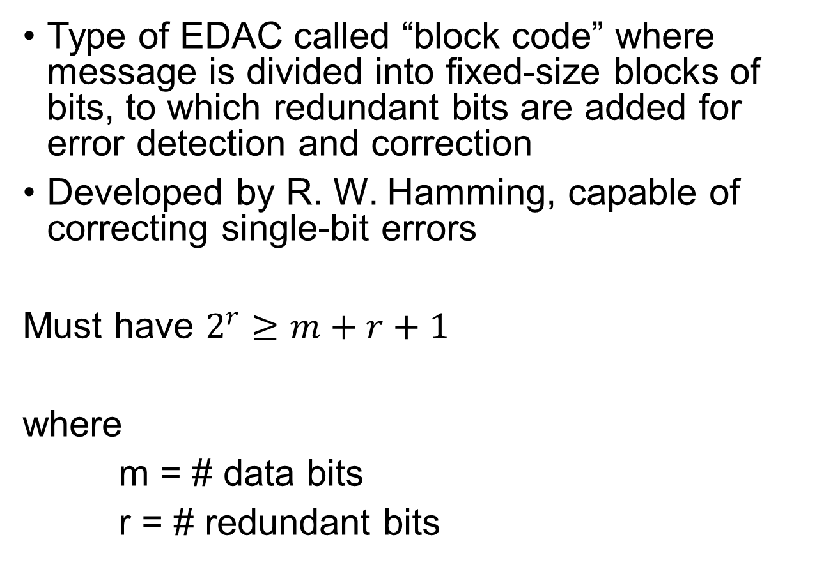
Hamming Code
Type of EDAC called “block code” where message is divided into fixed-size blocks of bits, to which redundant bits are added for error detection and correction
Developed by R. W. Hamming, capable of correcting single-bit errors
Must have $2^{r}≥m+r+1$
where
m = # data bits
r = # redundant bits

Slide 25
Example: Hamming Code
Given: 7 data bits, even parity
message: 1011001
Find:
Using Hamming code for single error detection and correction, determine sent message in binary.
Not knowing the sent message, the ground receives the following message: 10001001110. The ground knows only that there were 7 message bits and 4 redundancy bits. Determine if there are any errors and if so, which bit has an error.

Slide 26
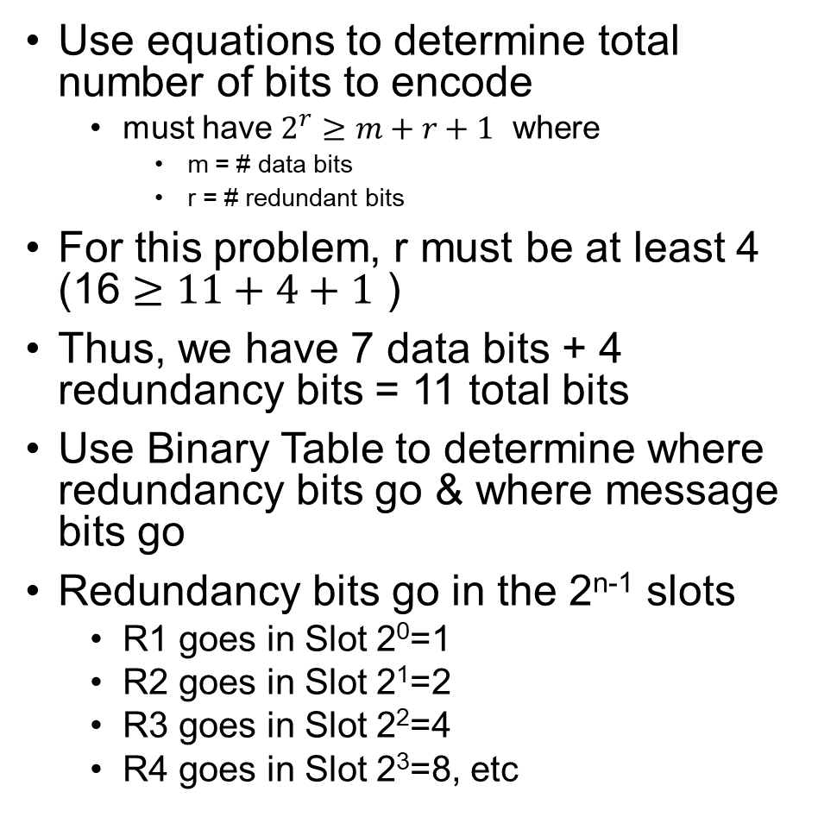
Solution (1/3)
Use equations to determine total number of bits to encode
must have $2^{r}≥m+r+1$ where
m = # data bits
r = # redundant bits
For this problem, r must be at least 4 (16 $≥11+4+1$ )
Thus, we have 7 data bits + 4 redundancy bits = 11 total bits
Use Binary Table to determine where redundancy bits go & where message bits go
Redundancy bits go in the 2^{n-1} slots
R1 goes in Slot 2⁰=1
R2 goes in Slot 2¹=2
R3 goes in Slot 2²=4
R4 goes in Slot 2³=8, etc
# | 2³ | 2² | 2¹ | 2⁰
0 | 0 | 0 | 0 | 0
1 | 0 | 0 | 0 | 1
2 | 0 | 0 | 1 | 0
3 | 0 | 0 | 1 | 1
4 | 0 | 1 | 0 | 0
5 | 0 | 1 | 0 | 1
6 | 0 | 1 | 1 | 0
7 | 0 | 1 | 1 | 1
8 | 1 | 0 | 0 | 0
9 | 1 | 0 | 0 | 1
10 | 1 | 0 | 1 | 0
11 | 1 | 0 | 1 | 1
12 | 1 | 1 | 0 | 0
13 | 1 | 1 | 0 | 1
14 | 1 | 1 | 1 | 0
15 | 1 | 1 | 1 | 1

Slide 27
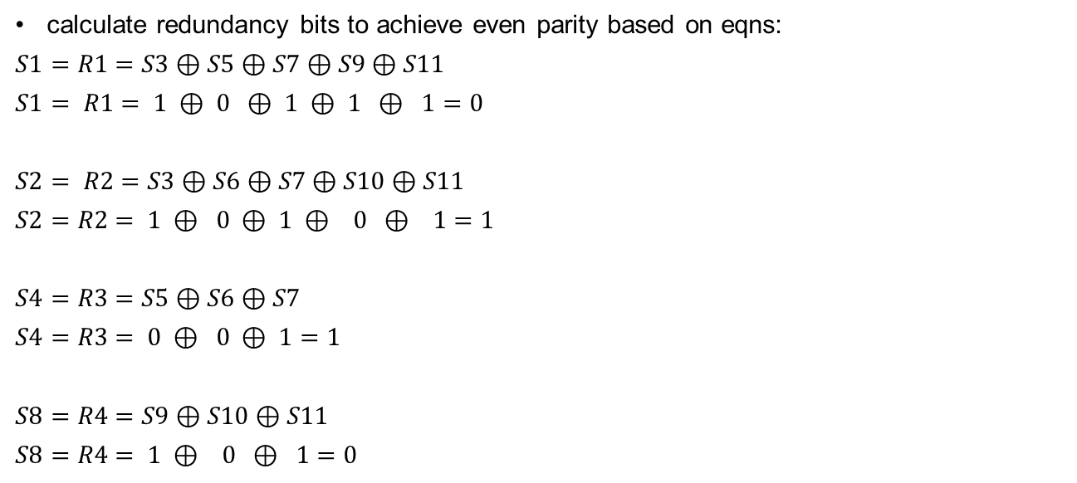
Solution (2/3) – Part a
 | MSB |  |  |  |  |  |  |  |  |  | LSB
Slot | S11 | S10 | S9 | S8 | S7 | S6 | S5 | S4 | S3 | S2 | S1
Content | M7 | M6 | M5 | R4 | M4 | M3 | M2 | R3 | M1 | R2 | R1
Value | 1 | 0 | 1 |  | 1 | 0 | 0 |  | 1
Sent message | 1 | 0 | 1 | 0 | 1 | 0 | 0 | 1 | 1 | 1 | 0
calculate redundancy bits to achieve even parity based on eqns:
$S1=R1=S3⊕S5⊕S7⊕S9⊕S11$
$S1= R1= 1 ⊕ 0 ⊕ 1 ⊕ 1 ⊕ 1=0$
$S2= R2=S3⊕S6⊕S7⊕S10⊕S11$
$S2=R2= 1 ⊕ 0 ⊕ 1 ⊕ 0 ⊕ 1=1$
$S4=R3=S5⊕S6⊕S7$
$S4=R3= 0 ⊕ 0 ⊕ 1=1$
$S8=R4=S9⊕S10⊕S11$
$S8=R4= 1 ⊕ 0 ⊕ 1=0$

Slide 28
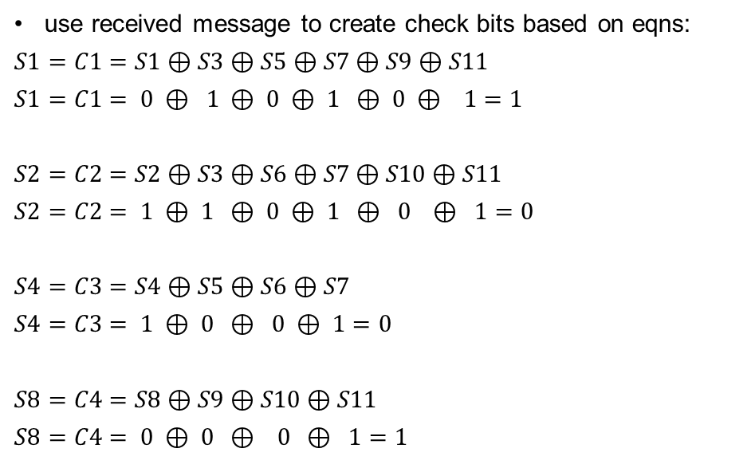
Solution (3/3) – Part b
 | MSB |  |  |  |  |  |  |  |  |  | LSB
Slot | S11 | S10 | S9 | S8 | S7 | S6 | S5 | S4 | S3 | S2 | S1
Content | M7 | M6 | M5 | R4 | M4 | M3 | M2 | R3 | M1 | R2 | R1
Value | 1 | 0 | 1 |  | 1 | 0 | 0 |  | 1
Recv’d message | 1 | 0 | 0 | 0 | 1 | 0 | 0 | 1 | 1 | 1 | 0
use received message to create check bits based on eqns:
$S1=C1=S1⊕S3⊕S5⊕S7⊕S9⊕S11$
$S1=C1= 0 ⊕ 1 ⊕ 0 ⊕ 1 ⊕ 0 ⊕ 1=1$
$S2=C2=S2⊕S3⊕S6⊕S7⊕S10⊕S11$
$S2=C2= 1 ⊕ 1 ⊕ 0 ⊕ 1 ⊕ 0 ⊕ 1=0$
$S4=C3=S4⊕S5⊕S6⊕S7$
$S4=C3= 1 ⊕ 0 ⊕ 0 ⊕ 1=0$
$S8=C4=S8⊕S9⊕S10⊕S11$
$S8=C4= 0 ⊕ 0 ⊕ 0 ⊕ 1=1$
create the binary number:
C4 C3 C2 C1 = (binary location of the error)
value of zero means rcvd msg is same as sent msg
C4 C3 C2 C1 = 1 0 0 1 = 9
Bit 9 has an error!

